Slide 1

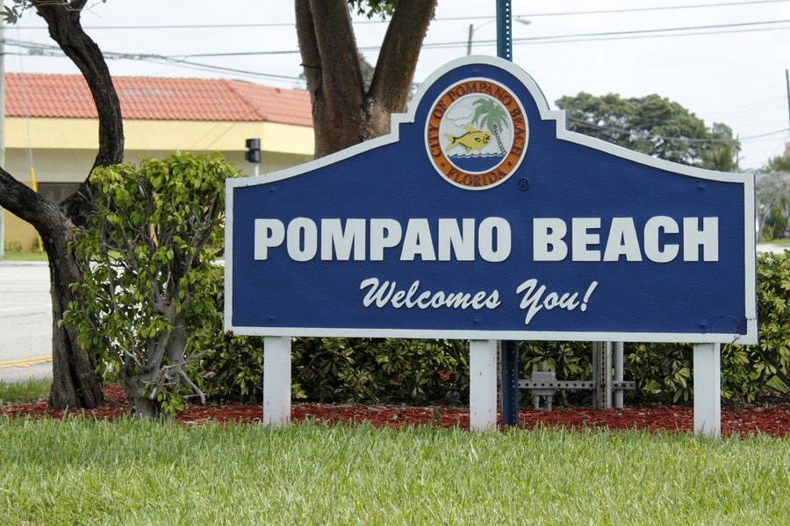
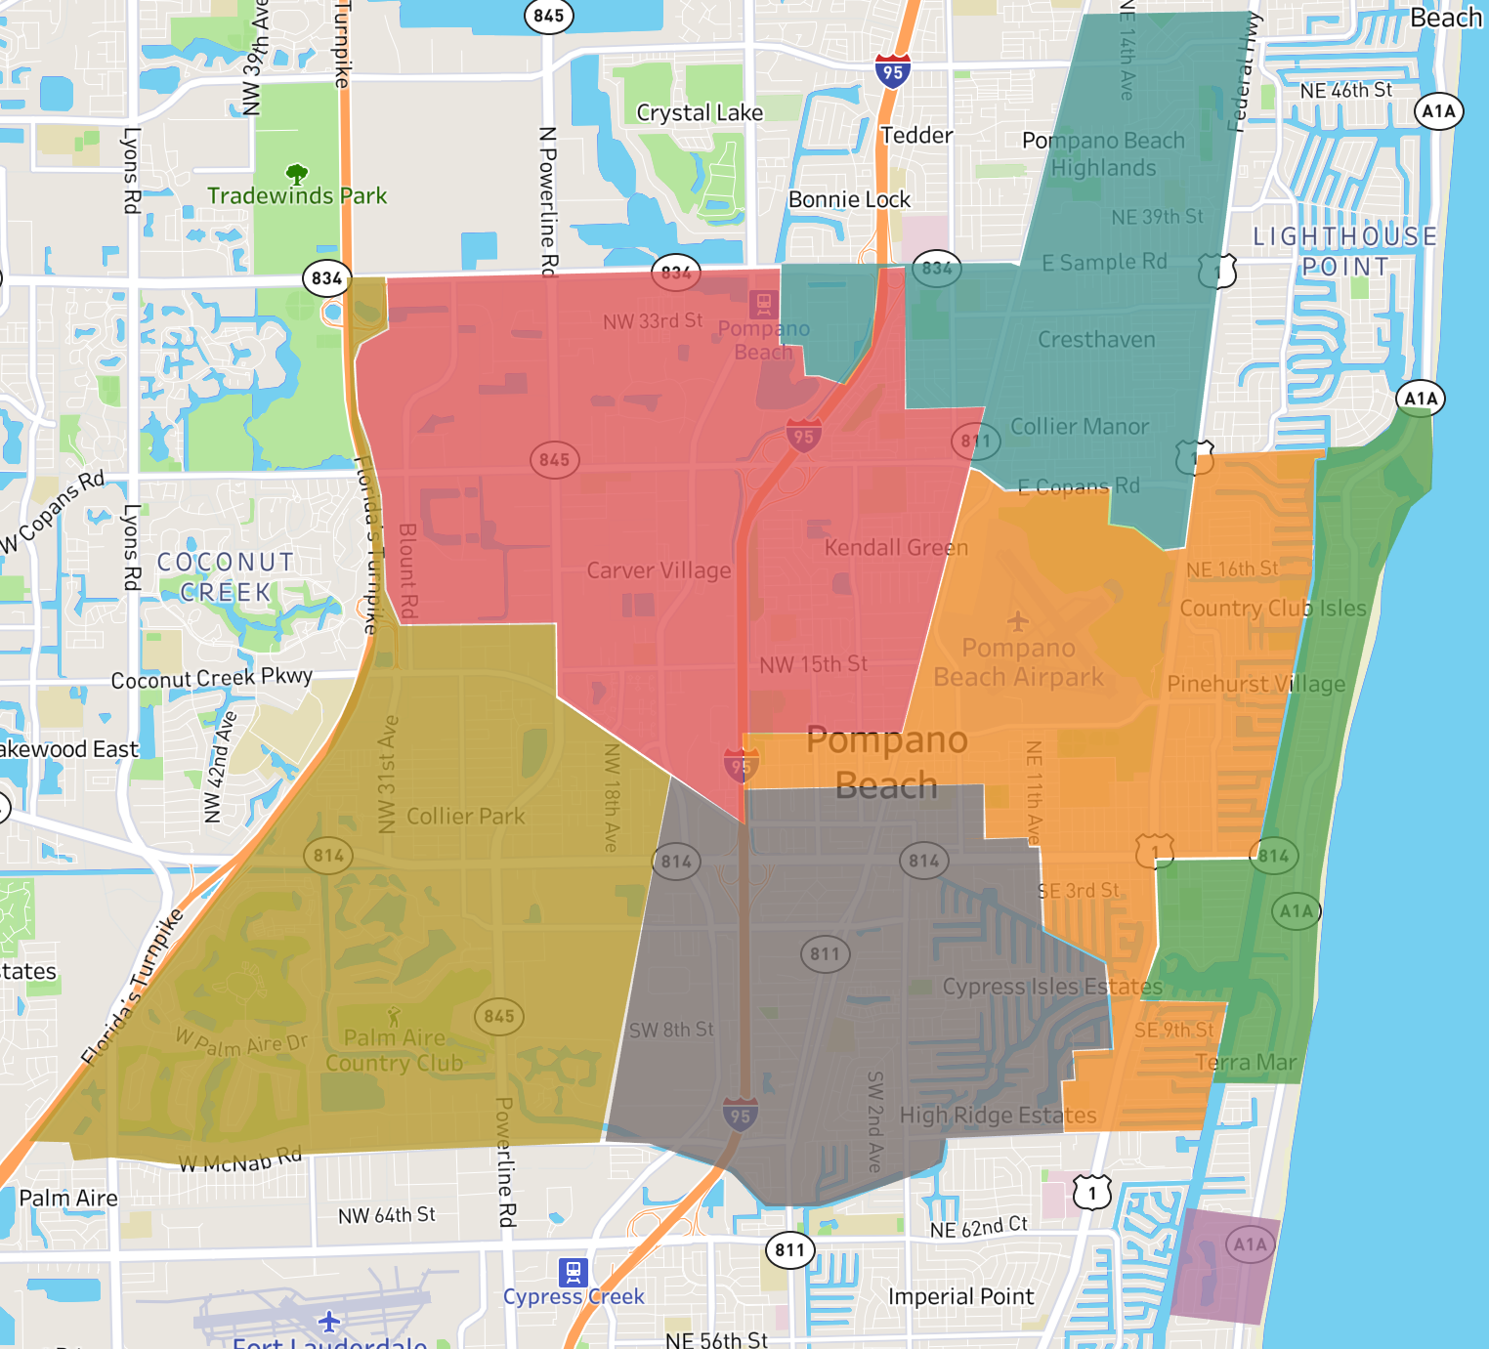
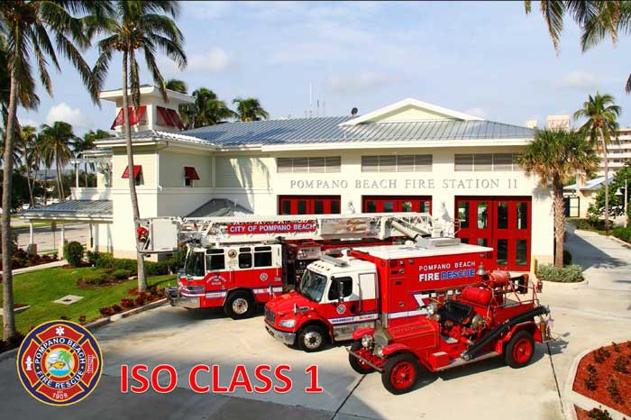
Fire Department Performance Brief Analysis
103
61
24
52
11
63
12c
Denisse Disla, Data Analyst Applicant

Slide 2
Aim
Visually supplement aggregated data offered on various performance briefs in hopes to extract insights.
Not intended as a stand alone performance brief, and therefore will not introduce the ‘who we are’ and ‘what we do’ sections.
Software used: Python, Tableau and Excel

Slide 3
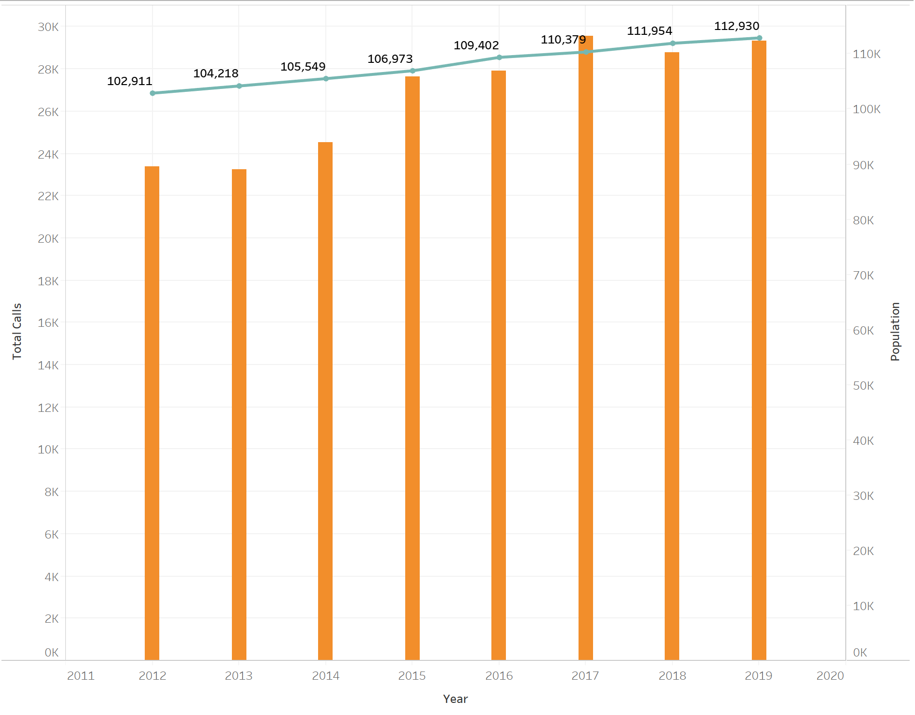
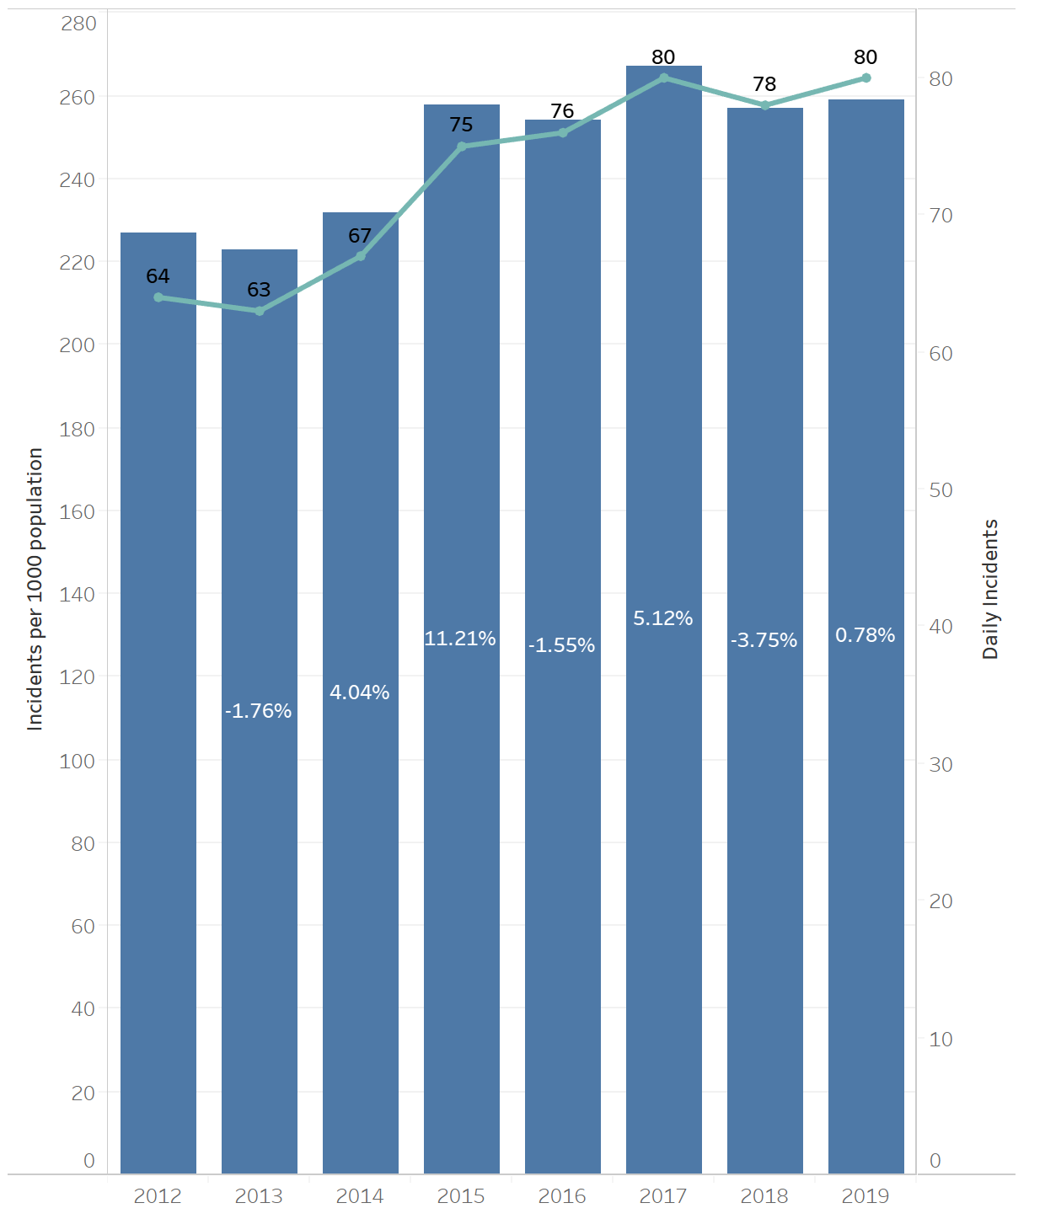
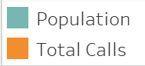

Total calls throughout years compared to population growth
Incidents per capita compared to daily incidents throughout years
Percentages show percent difference compared to last year
Key Insights
There doesn’t seem to be a direct relationship between total number of calls/incidents and population
2015 saw a big increase in total number of incidents, with an overall 11.21% increase compared to 2014
Average daily incidents since 2015 range between 75 and 80
Average growth rate since 2015 has been 2.36% per year

Slide 4
Zone Analysis

Slide 5
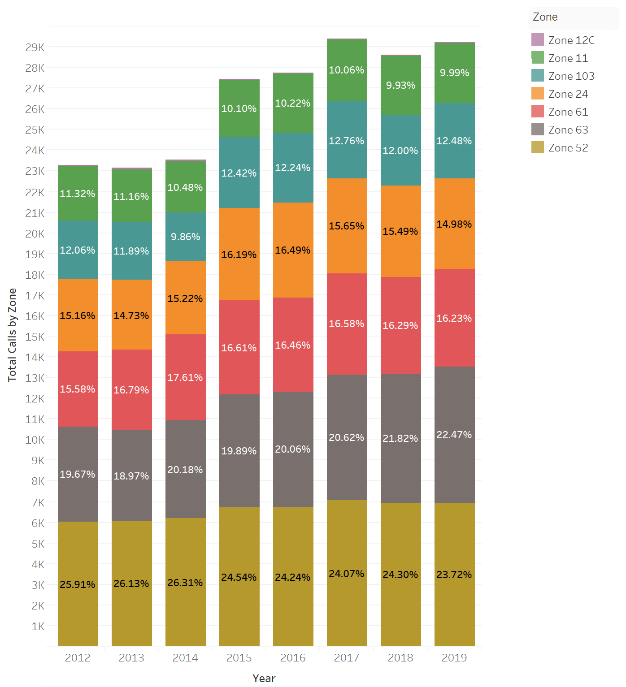
Distribution of Incidents throughout FD Zones
Number of Incidents by Zone throughout Years
(displays percent of total incidents for each Zone by Year)
Key Insights
Overall increase of total incidents throughout the years
Biggest increase in total number of incidents was in 2015
Zone 52 is consistently the most demanding zone accounting for a quarter of annual incidents.
However, its percent of total has declined slightly in recent years, whereas Zone 63 has been increasing
Almost half of the 2019 incidents are centered in Southwest/Southcentral Pompano Beach (Zone 52+63)
Zone 12C barely contributes to incidents
Growth
Growth rate for Zones 52, 11 and 12c are relatively stable across time
Zone 103 is the most variable (and thus least predictable) zone.
It is also the zone that saw the highest increase in incidents in 2015, with a 47% increase compared to 2014
Zone 63 has been consistently growing, with an average growth rate of 4.75% per year since 2016

Slide 6
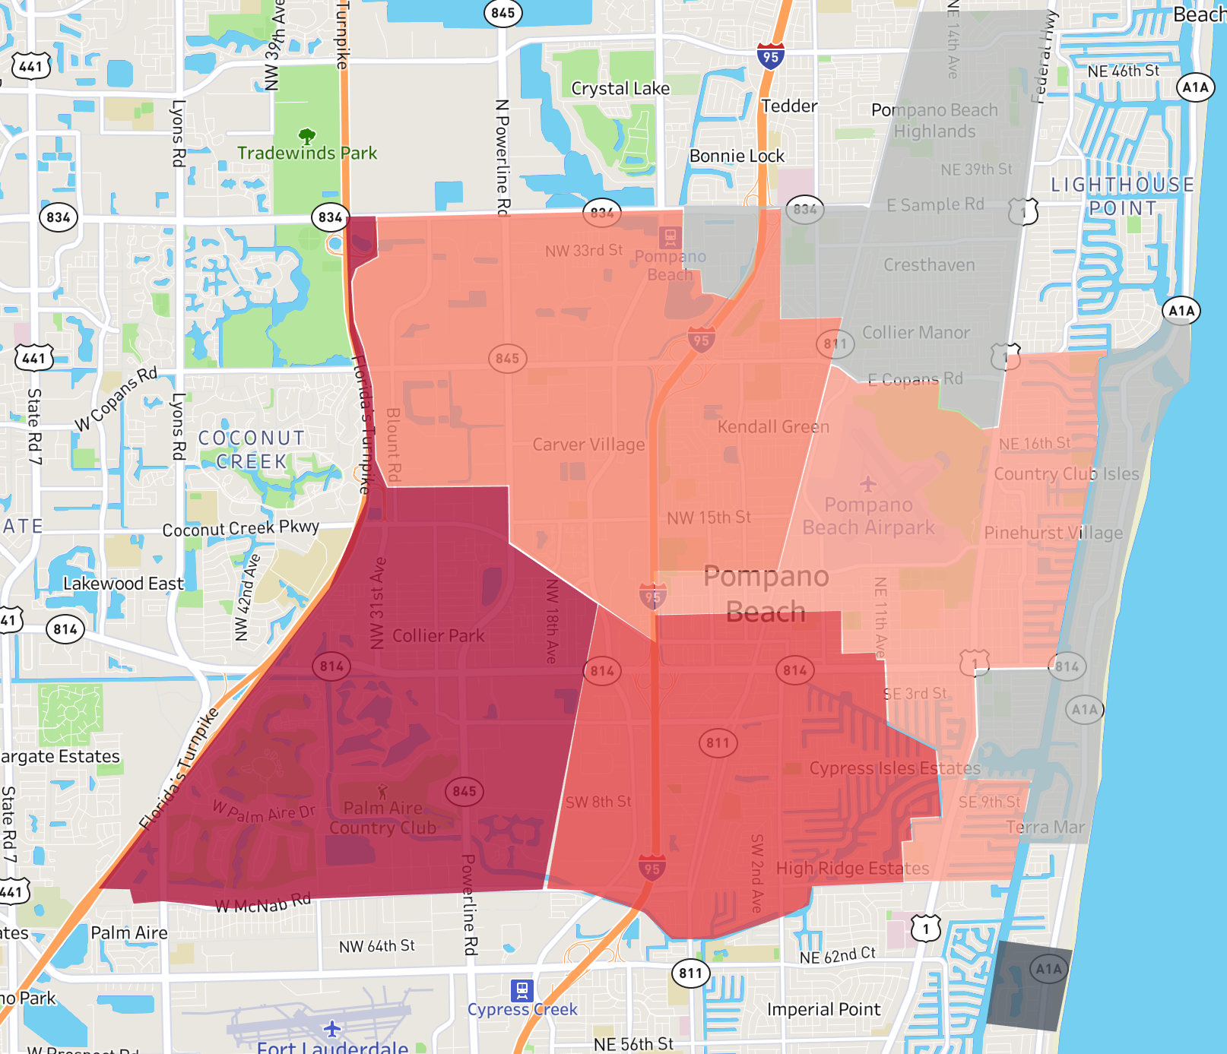
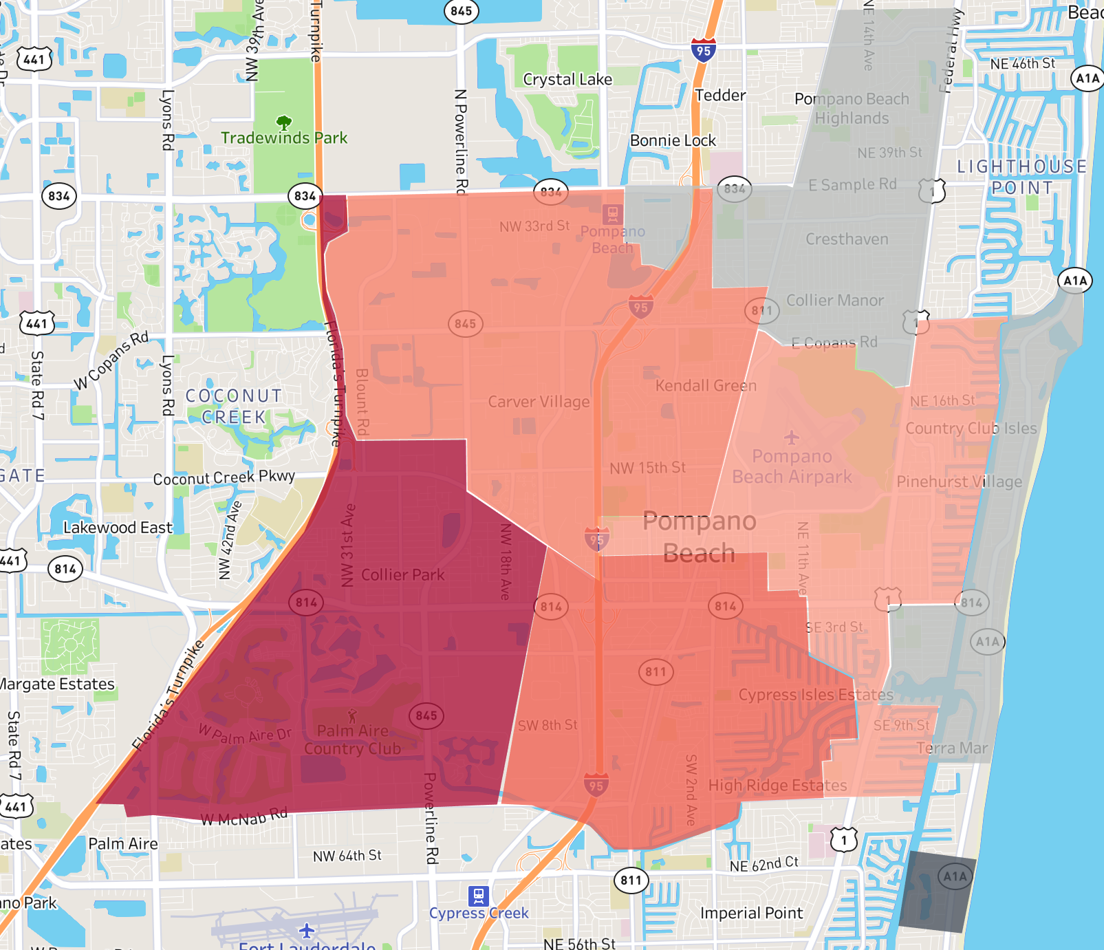
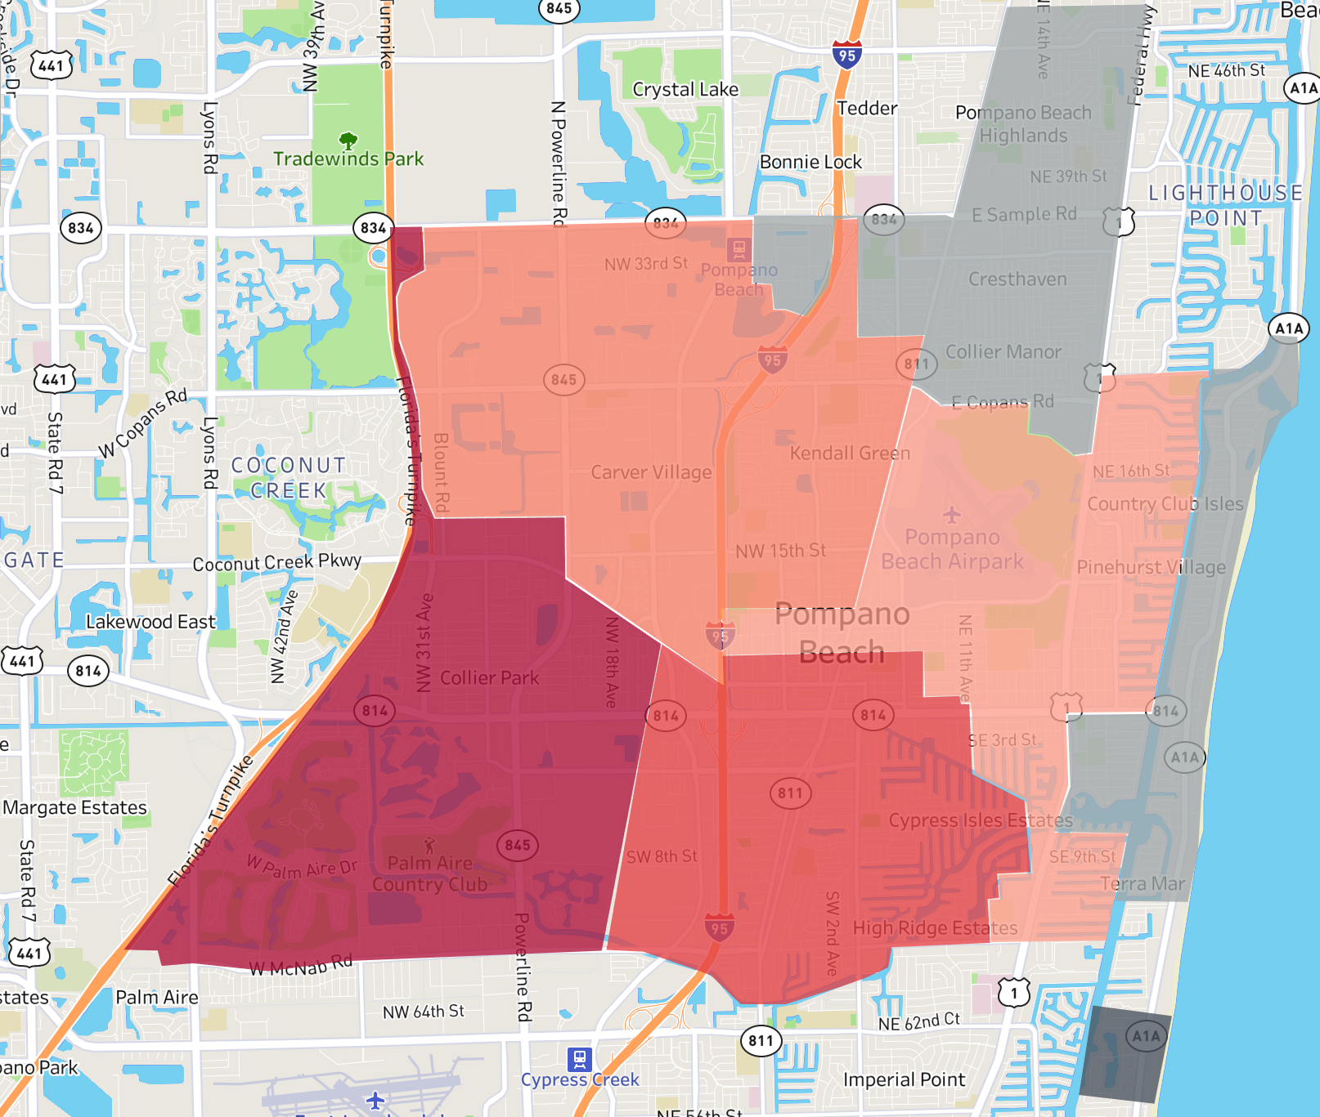
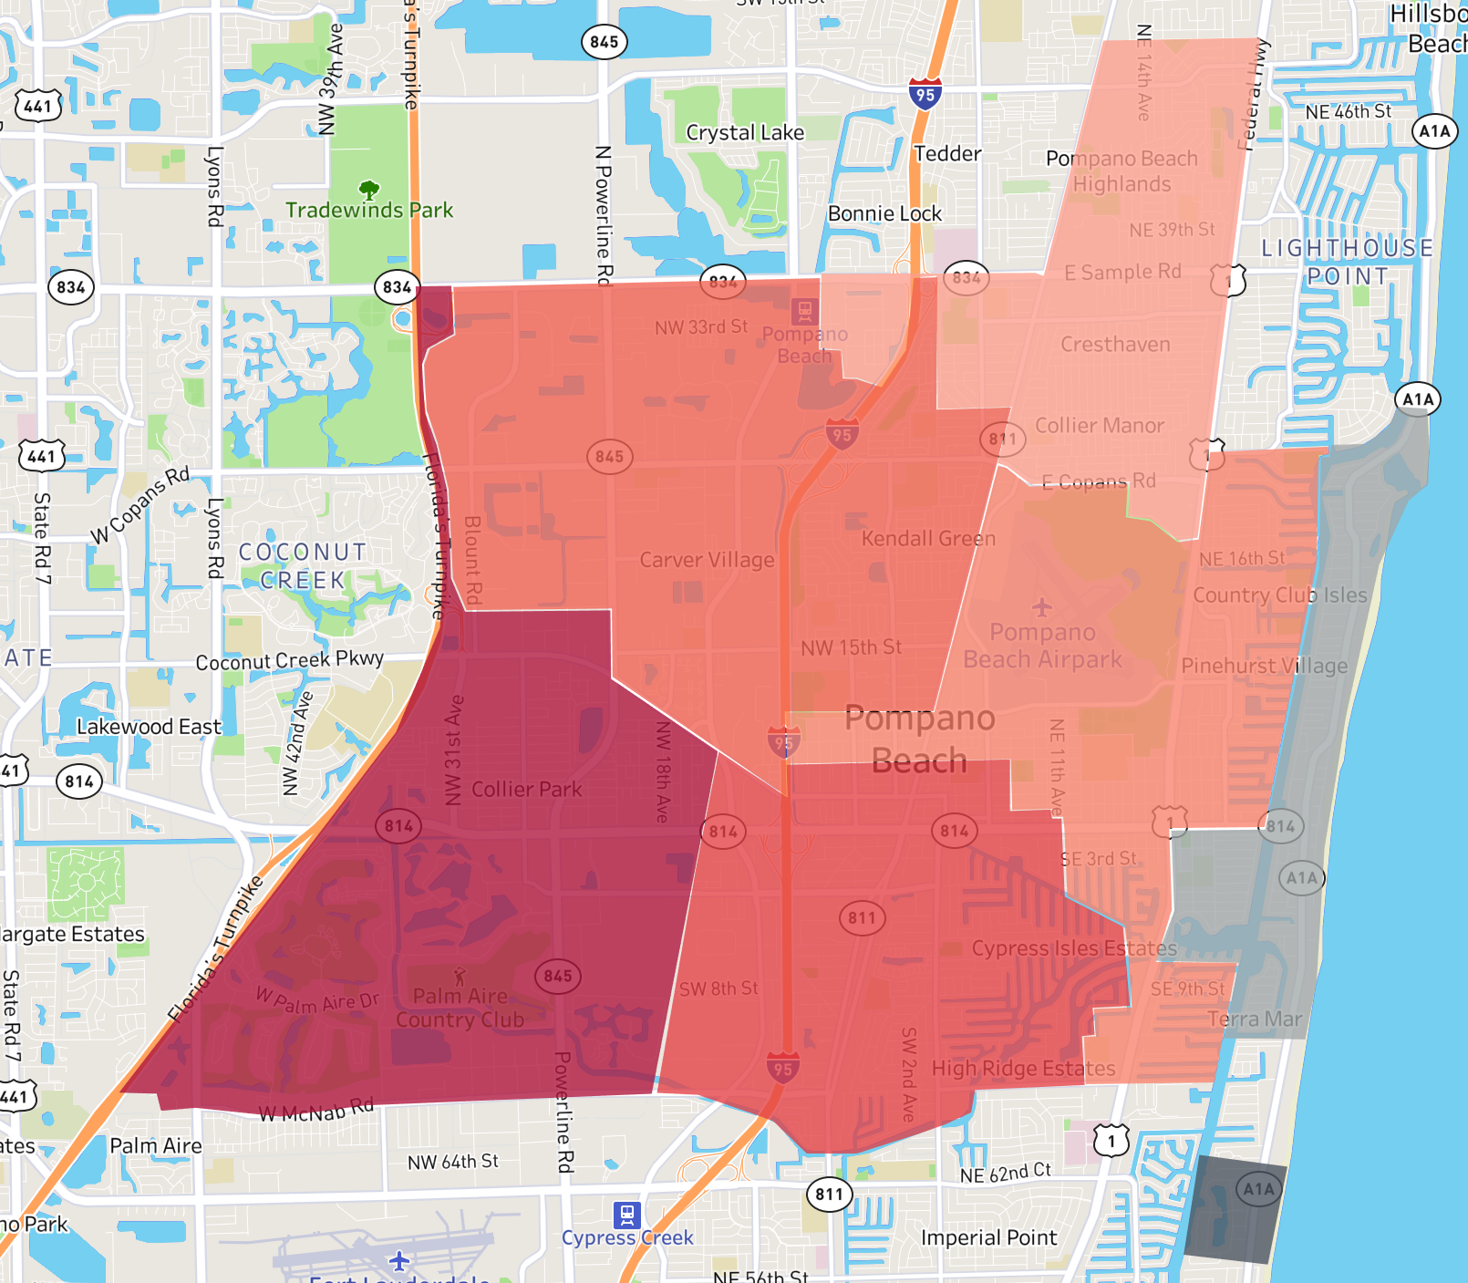
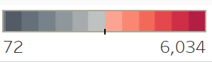
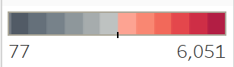
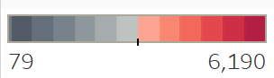
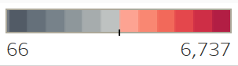
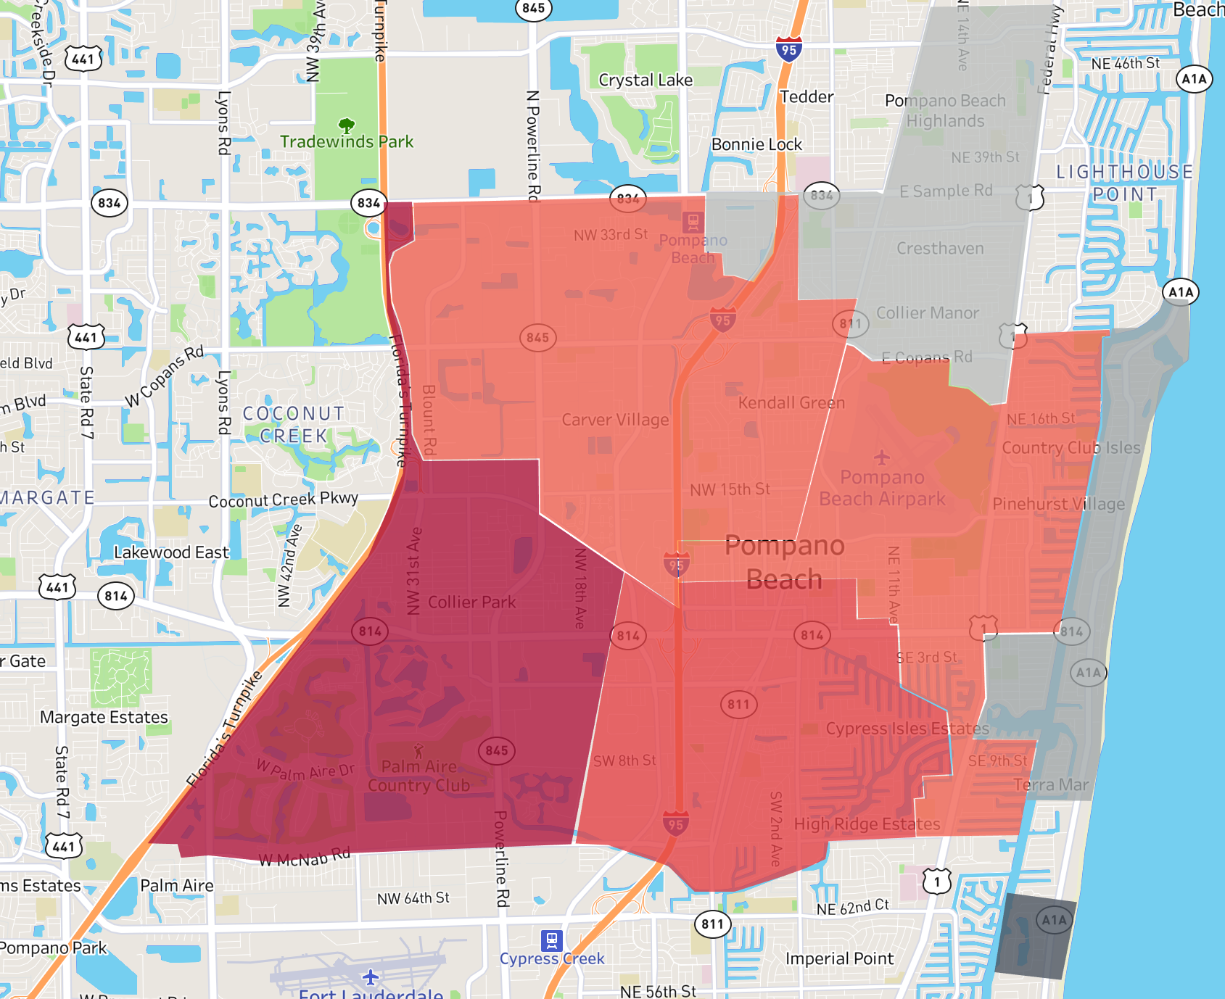
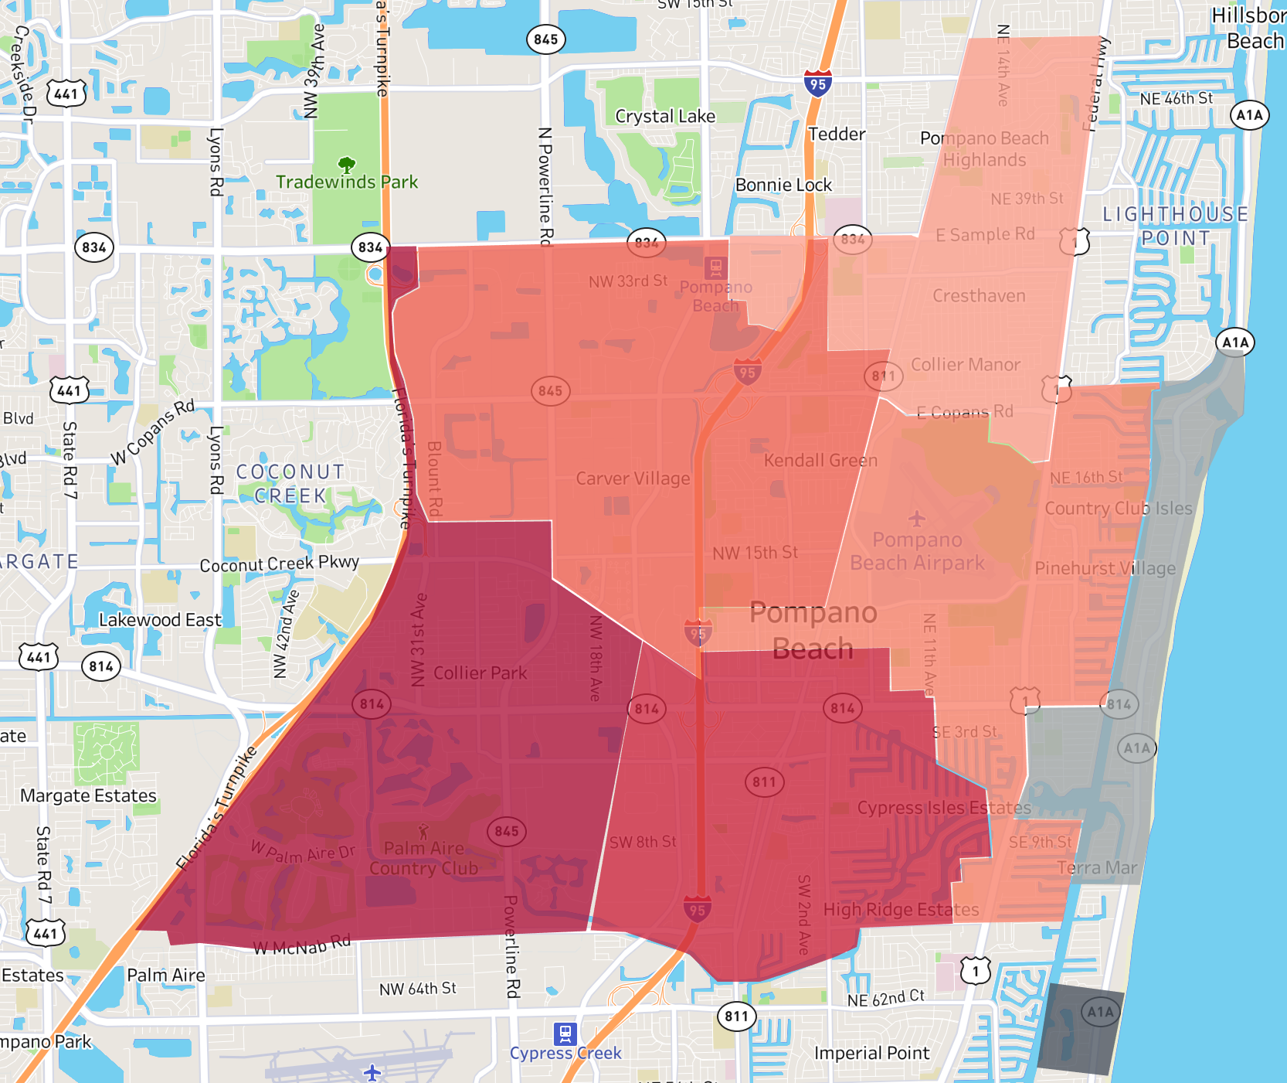
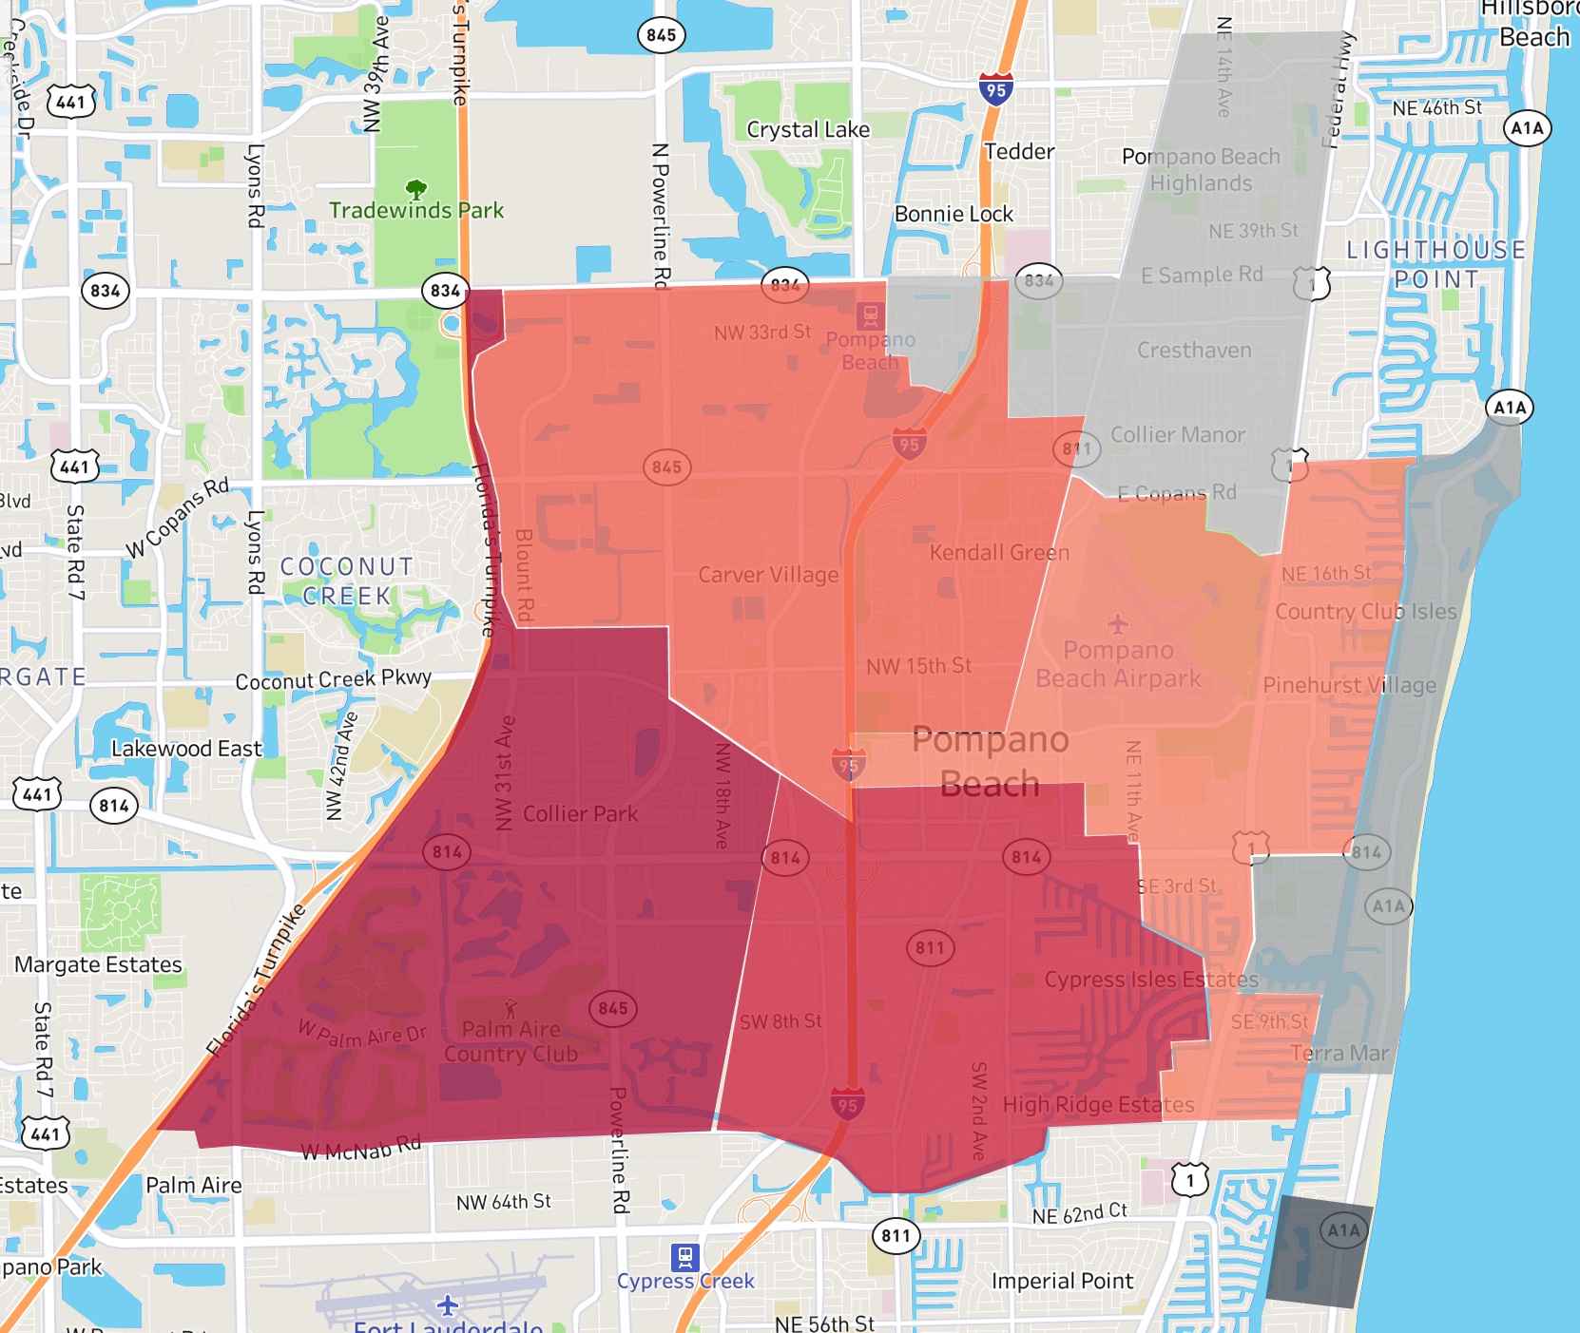
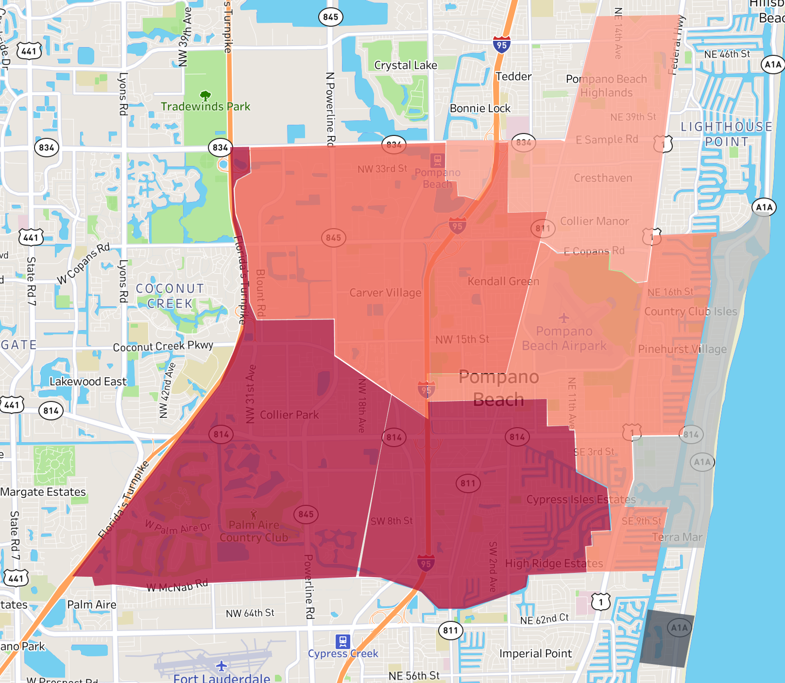
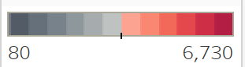
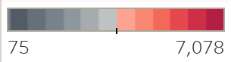
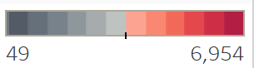
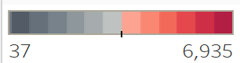
Incident Volume by Zone throughout Years
(darker red indicates higher volume)
103
103
103
103
61
61
61
61
24
24
24
24
52
11
52
11
52
11
52
11
63
63
63
63
12C
12C
12C
12C
2012
2013
2014
2015
103
103
103
103
61
61
61
61
24
24
24
24
52
11
52
11
52
11
52
11
63
63
63
63
12C
12C
12C
12C
2016
2017
2018
2019

Slide 7
Calls by Incident Type Analysis

Slide 8
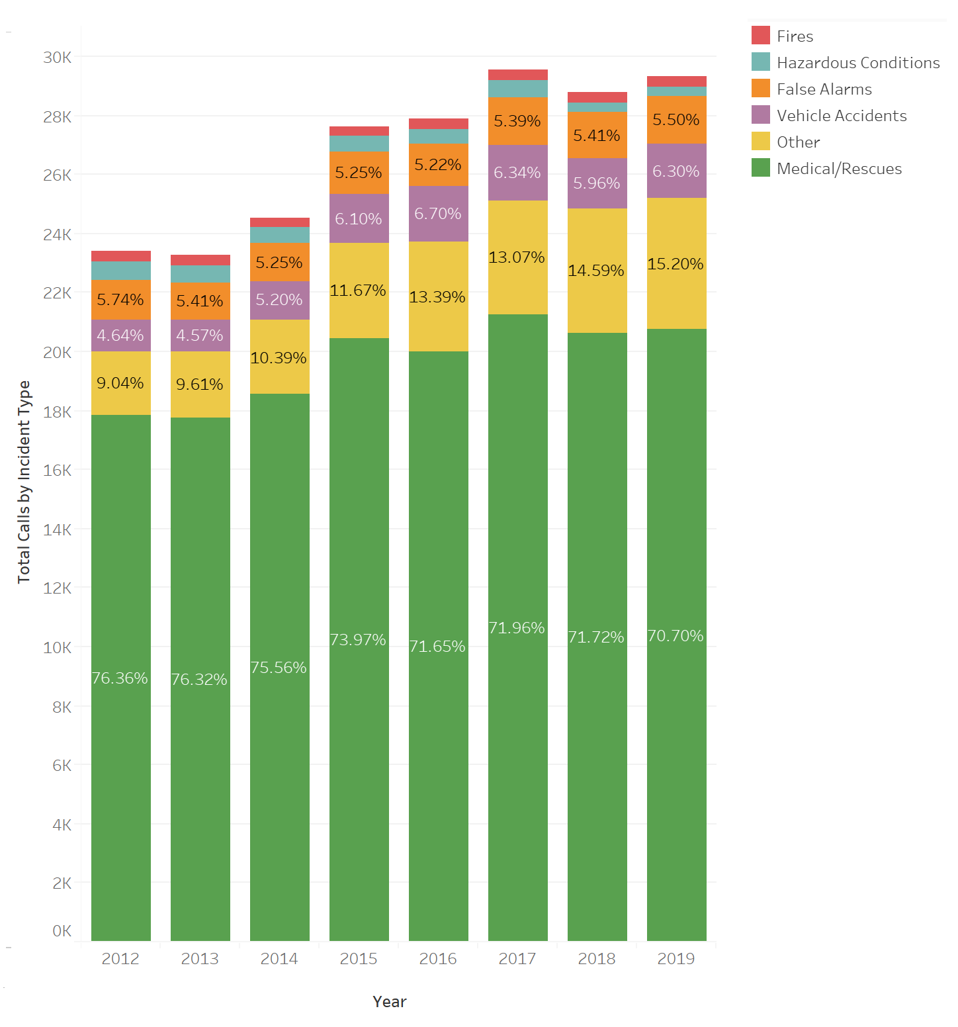
Total Calls by Incident Type throughout Years
(displays percent of total incidents for each Incident Type by Year)
Call volume based on Incident Type
Key Insights
Medical/Rescues consistently account for around three quarters of all incidents
Incidents labelled ‘Other’ are contributing more and more to the total number of incidents each year. Good to classify further to understand trends, and better train workforce
Fires constitute a small amount of total incidents per year
Important to take into consideration distribution of incident type when planning educational sessions, to tailor based on what incidents are affecting population the most
Would be interesting to see how population demographics influence distribution of incident type between various cities

Slide 9
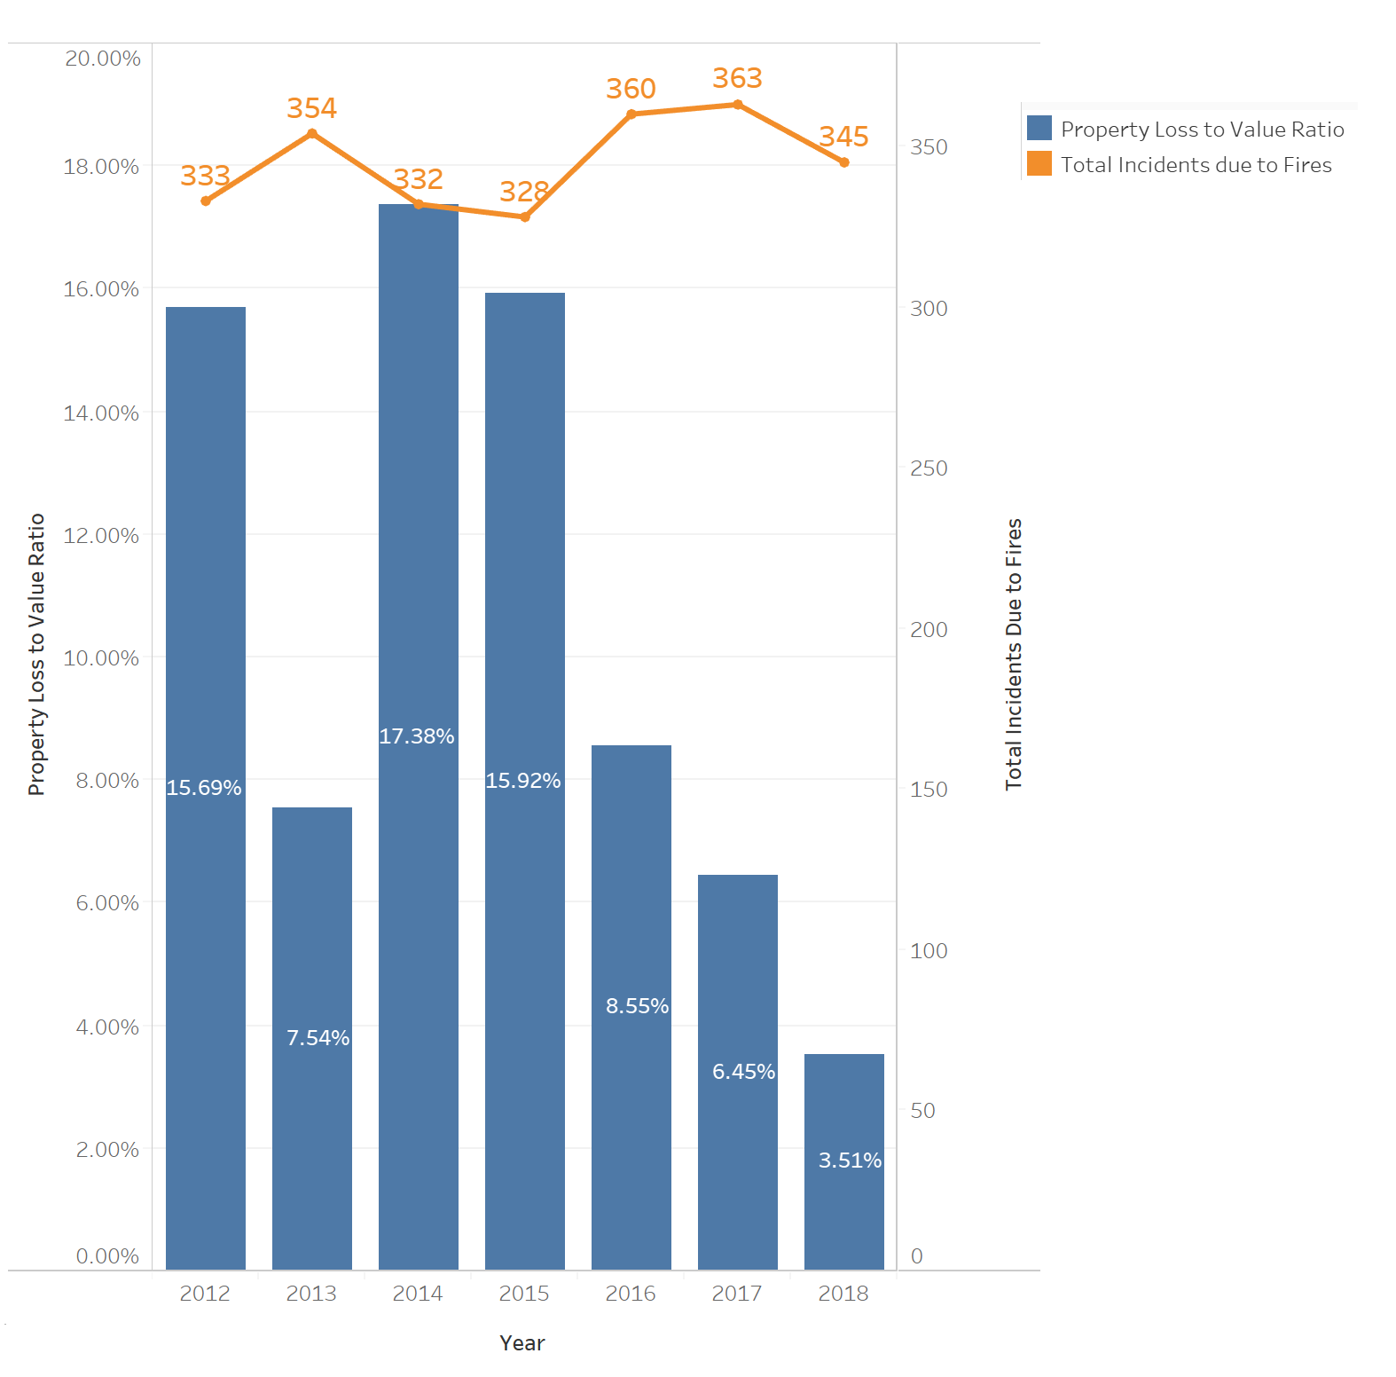
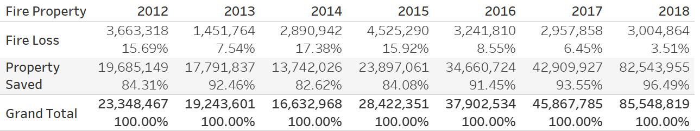
Fires
Analysis of incidents volume and property loss to value ratio
The 3 years with the least amount of fire incidents (2012, 2014, and 2015) were also the years that a higher amount of property was lost due to fire, compared to its value
Property loss to value ratio has been declining in recent years (despite higher occurrences of fires), suggesting strong effectiveness at combating fires
Key Insights
Note: Values obtained from Chart 1: Fire loss vs Property Value Saved from Performance Brief 2019, 1QTR. report

Slide 10
‘Day of Week’ Analysis

Slide 11
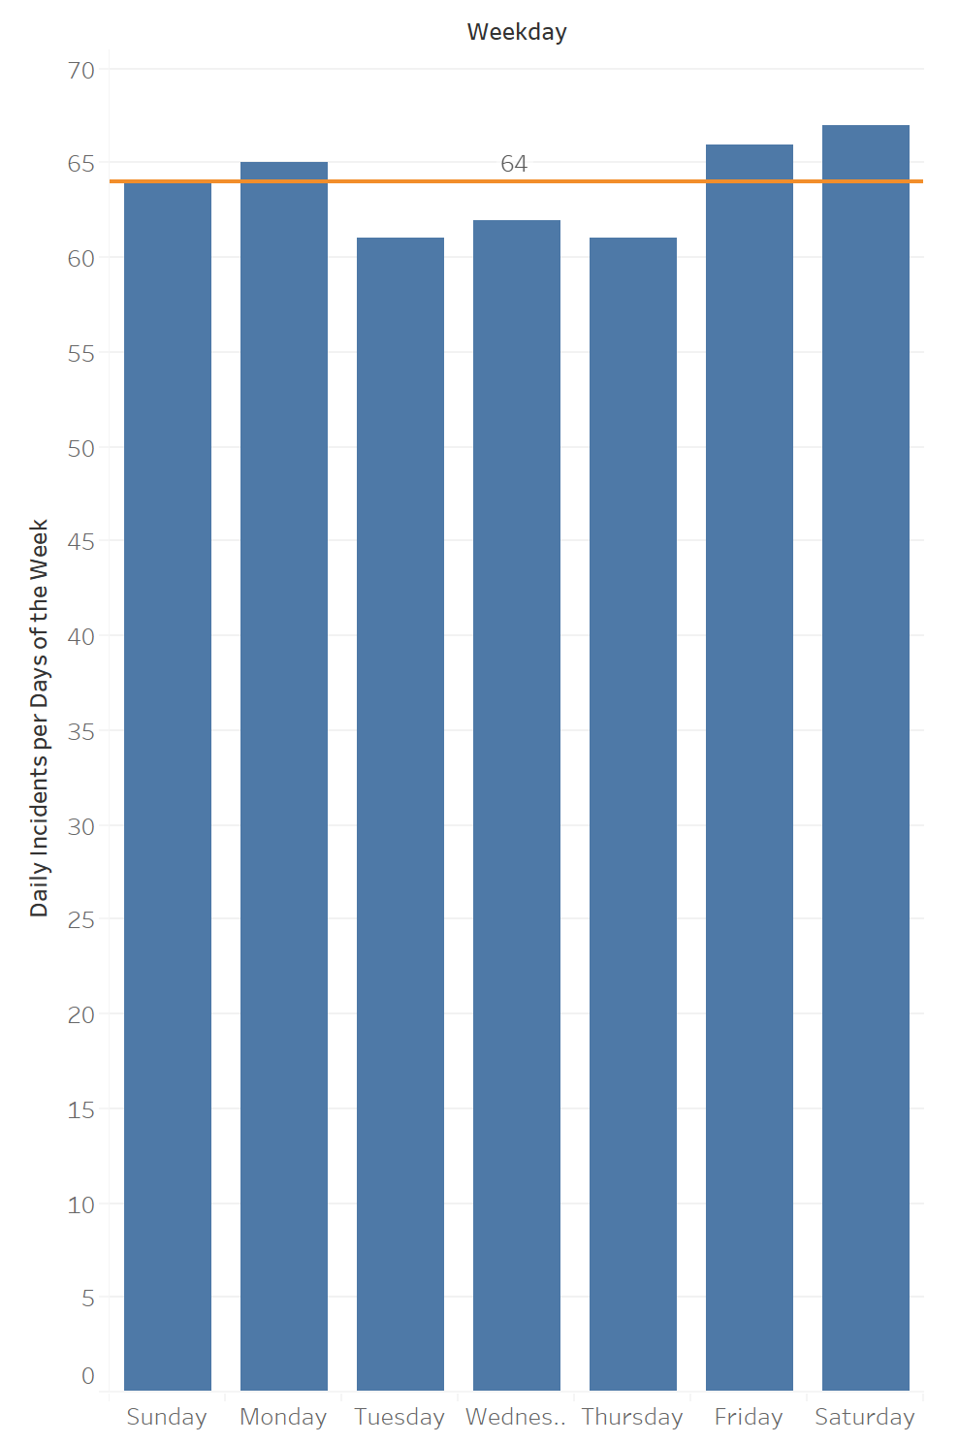
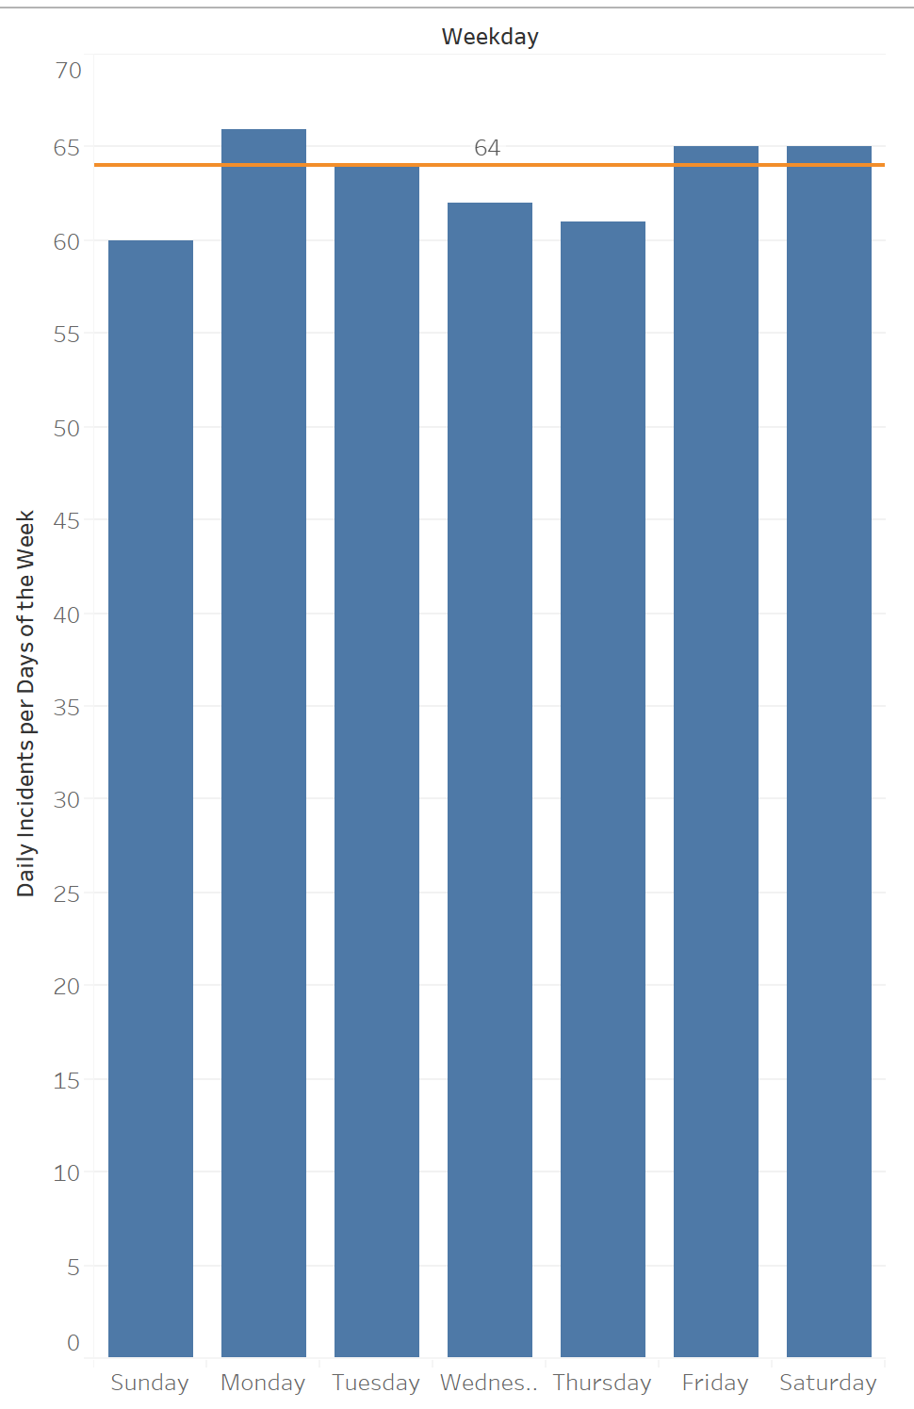
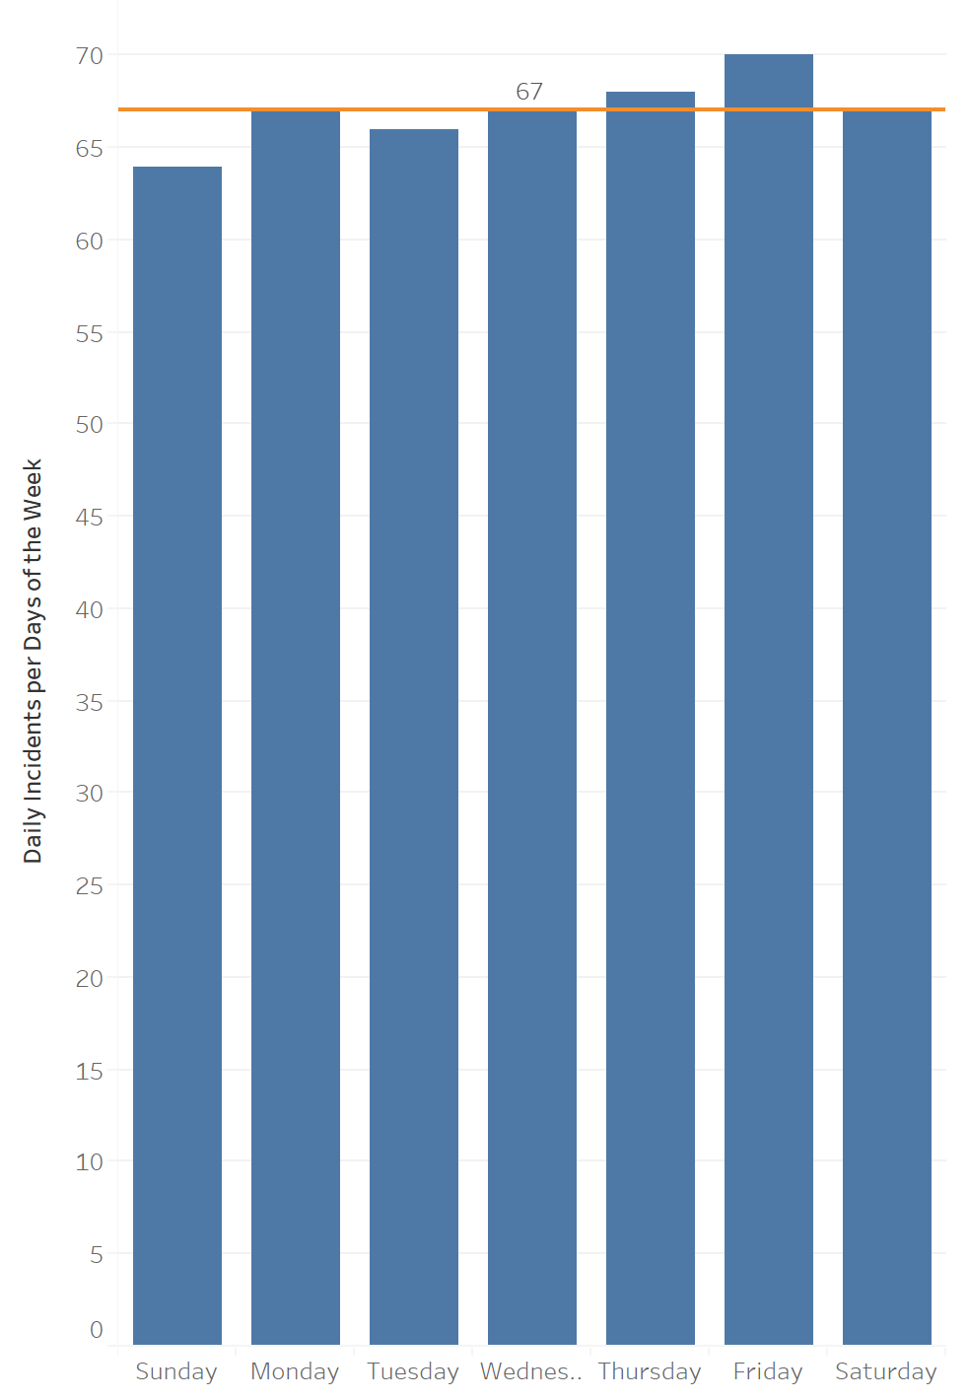
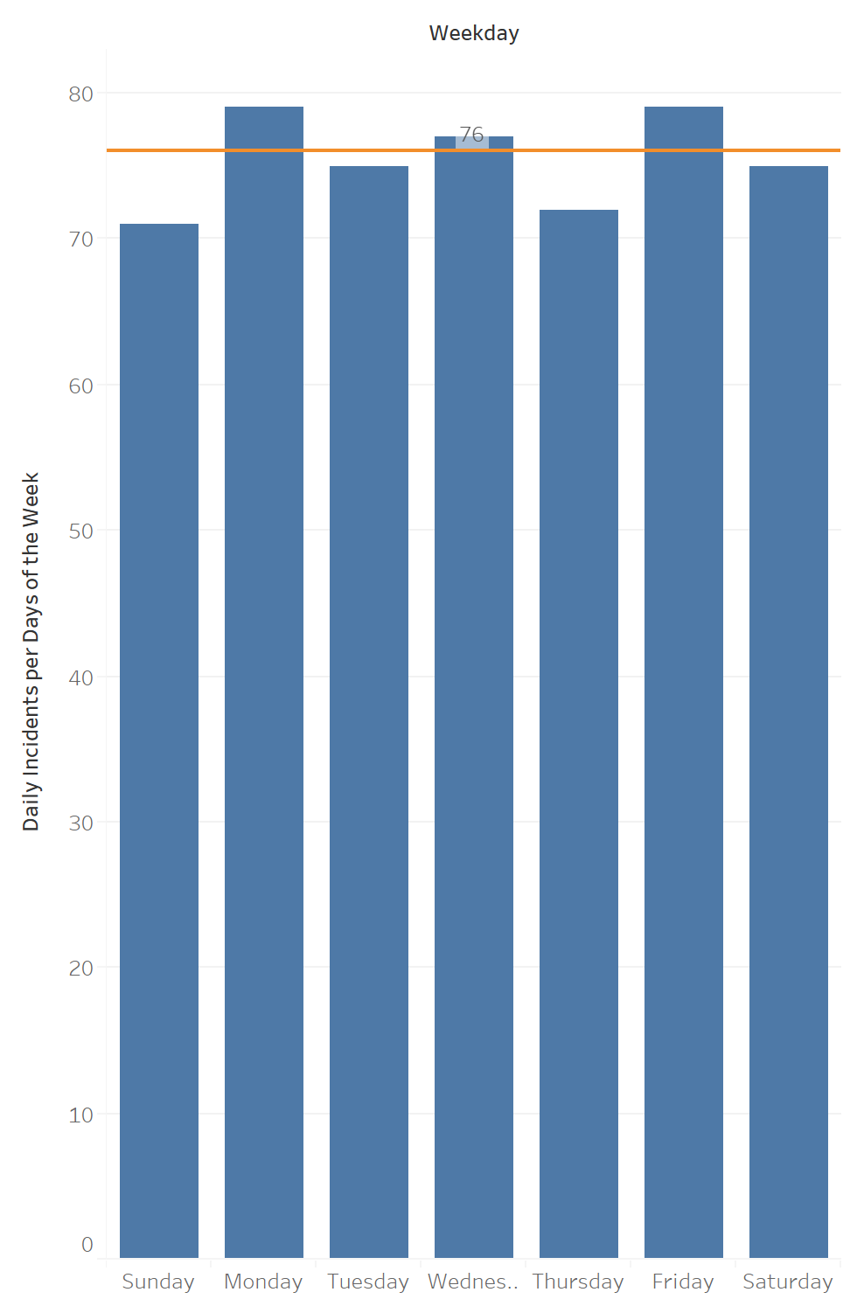
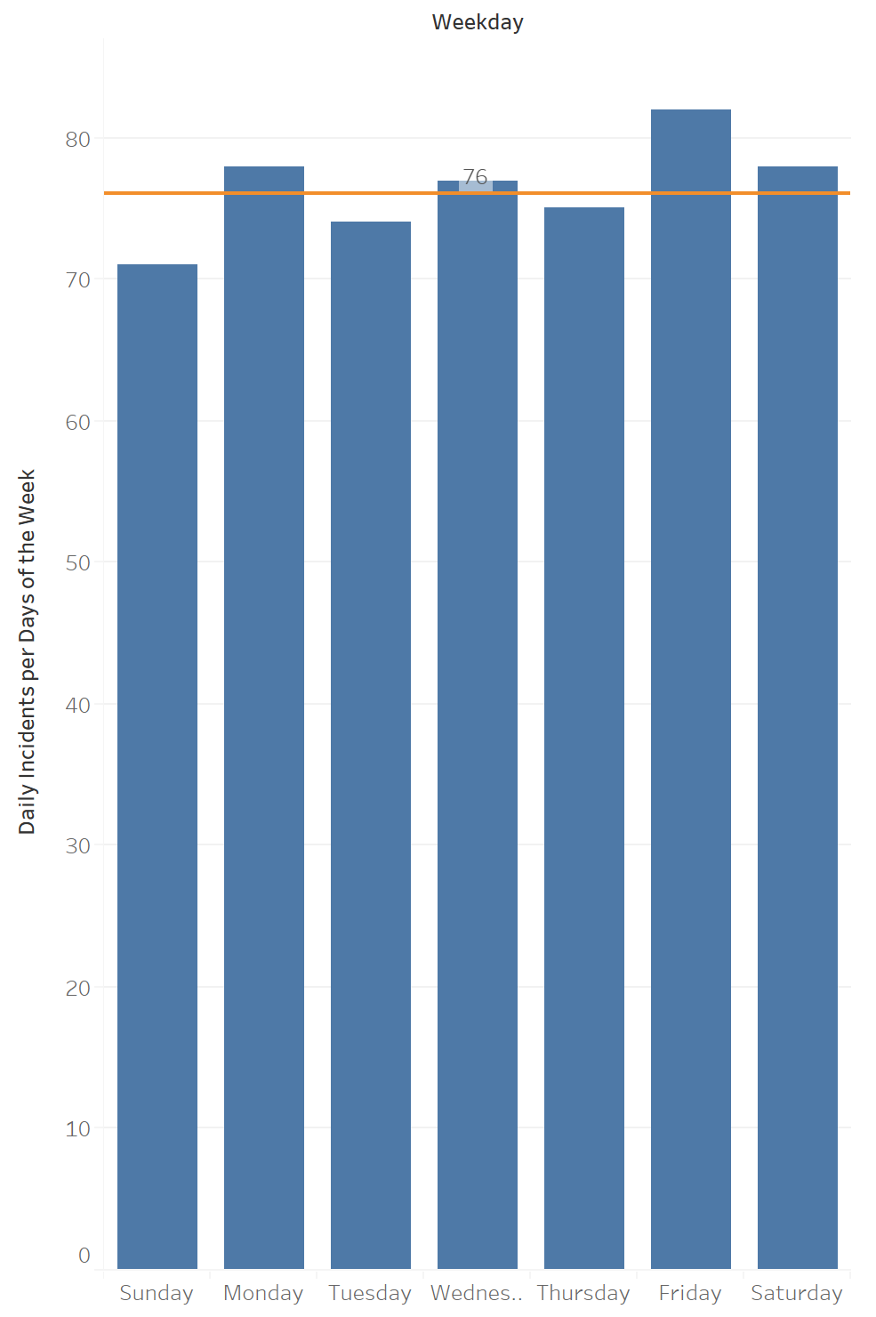
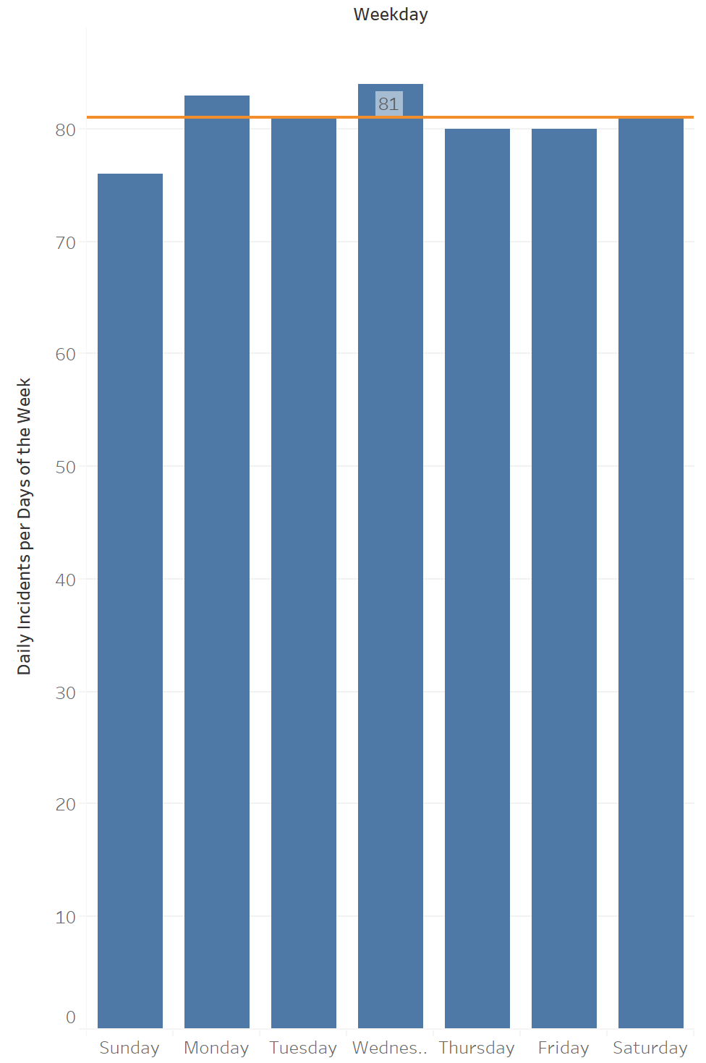
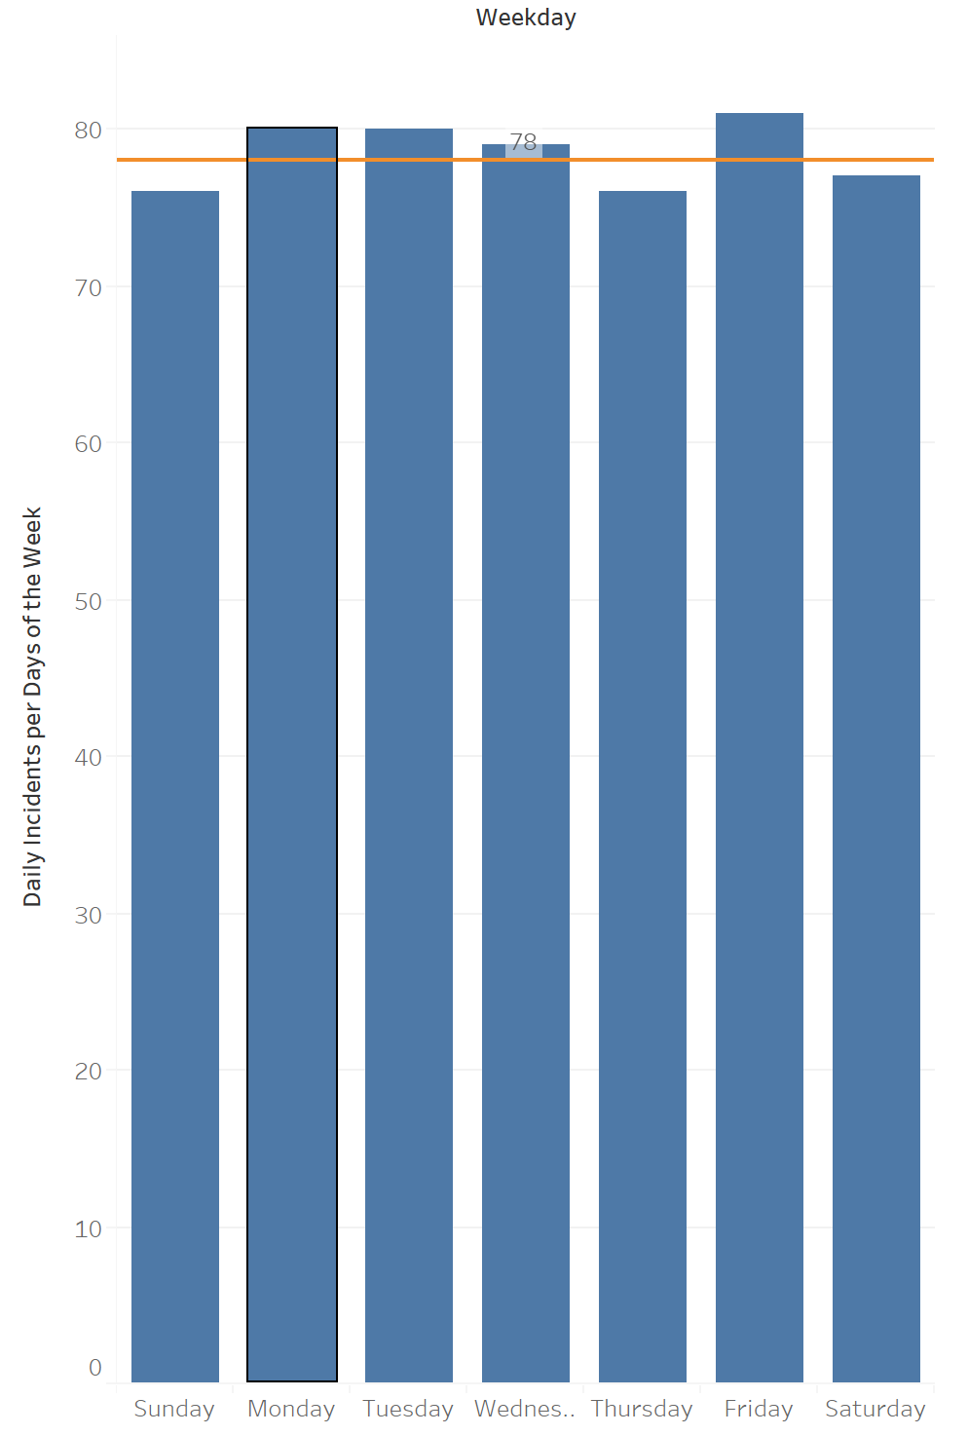
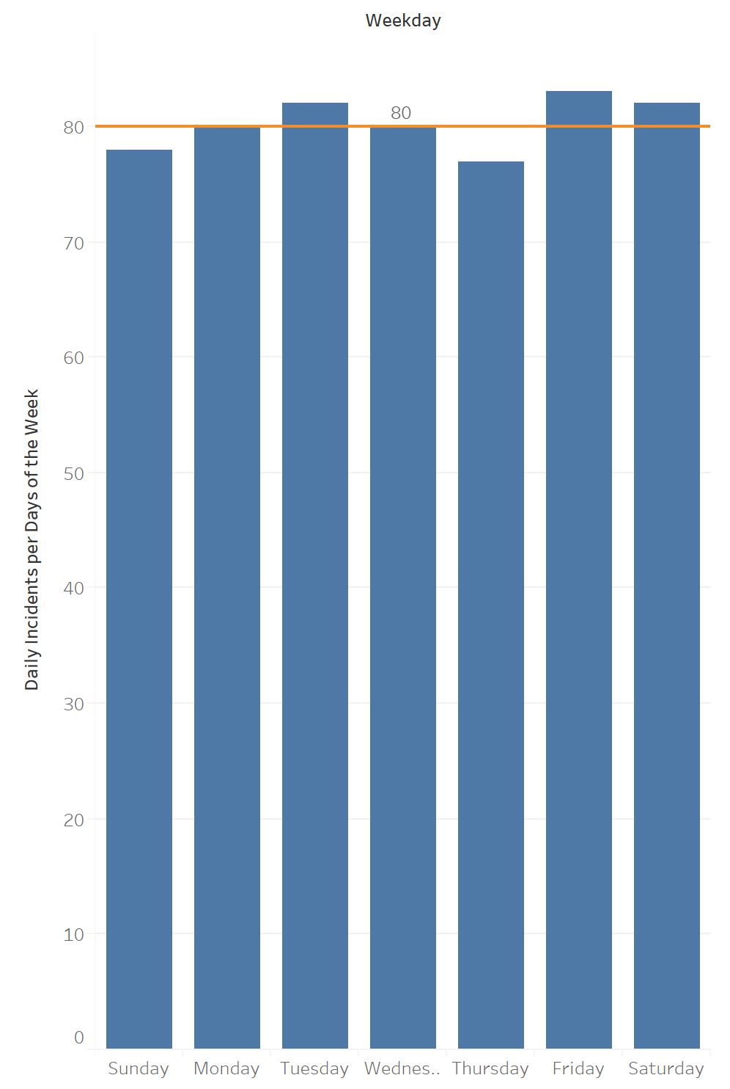
2012
2013
2014
2015
Are incidents evenly distributed across the week?
Chi Square tests for each year showed that incidents significantly varied widely based on day of the week
Orange line shows how many incidents were expected that particular year, you can see which days had more or less incidents than expected
= Important to consider when scheduling workforce in order to reduce overtime, worker fatigue, etc.
2016
2017
2018
2019

Slide 12
Are incidents evenly distributed across the week?
Table displays the total number of years (out of 8) that a particular weekday had a higher, exact, or lower number of incidents than expected if incidents were evenly distributed across the week
 | Over Expectation | Exact | Under Expectation | Total
Sunday |  | 1 | 7 | 8
Monday | 6 | 2 |  | 8
Tuesday | 2 | 2 | 4 | 8
Wednesday | 4 | 2 | 2 | 8
Thursday | 1 |  | 7 | 8
Friday | 7 |  | 1 | 8
Saturday | 4 | 2 | 2 | 8
Mondays and Fridays are consistently busier than expected if all weekdays had the same number of incidents
Sundays and Thursdays are consistently less busy than expected if all weekdays had the same number of incidents

Slide 13
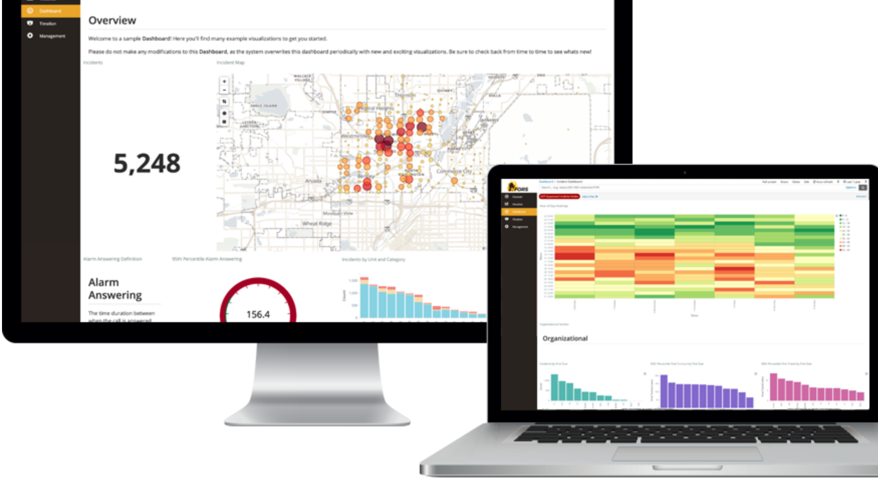
Fire Departments and Data Analytics
NFORS Analytics provides real time data analytics to undercover trends, improve operational efficiency and reduce risk and loss
Integrates directly to CAD or Records Management System for automatic extraction of operational data
Goes beyond call volume, including a private history for firefighters to track risk, fatigue, etc.

